Slide 1
COMPUTER VISION PROJECT
Final Evaluation
Abhishek Sharma
Rishabh malik
Piyush Atri
Devansh Dobriyal
(RC-SQUAD)

Slide 2
PAPER IMPLEMENTATION
“Dual Illumination Estimation
for
Robust Exposure Correction”
By - Qing Zhang, Yongwei Nie, and Wei-Shi Zheng

Slide 3
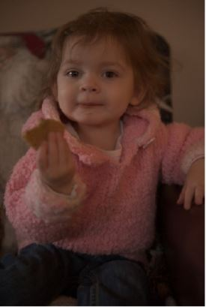
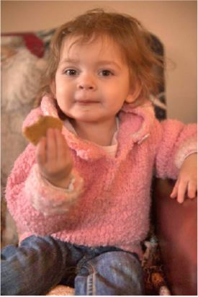
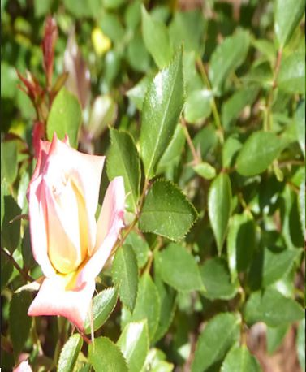
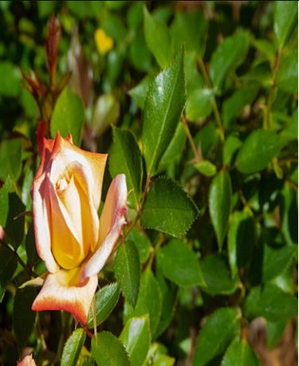
OBJECTIVE
To make an automatic exposure correction method.
Fixes both under-exposed and over-exposed images.

Slide 4
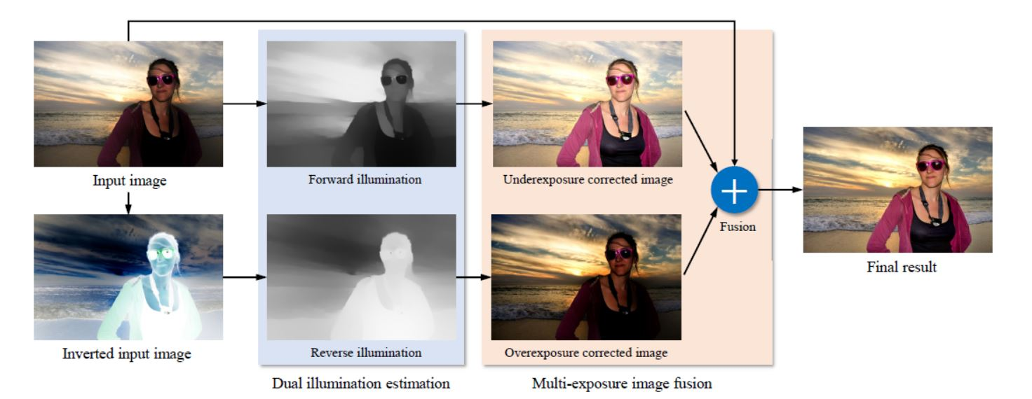
METHOD OVERVIEW

Slide 5
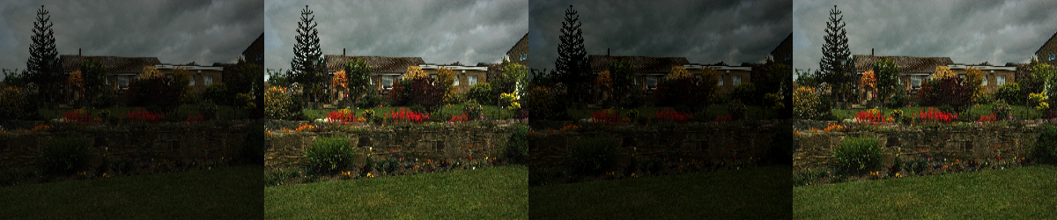
Dual ILLUMINATION METHOD on underexposed image
ORIGINAL IMAGE
FORWARD
ILLUMNINATION METHOD
BACKWARD
ILLUMNINATION METHOD
FUSED IMAGE

Slide 6
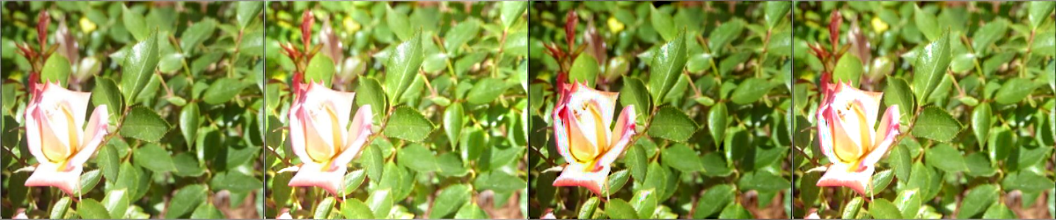
Dual ILLUMINATION METHOD on OVERexposed image
ORIGINAL IMAGE
FORWARD
ILLUMNINATION METHOD
BACKWARD
ILLUMNINATION METHOD
FUSED IMAGE

Slide 7



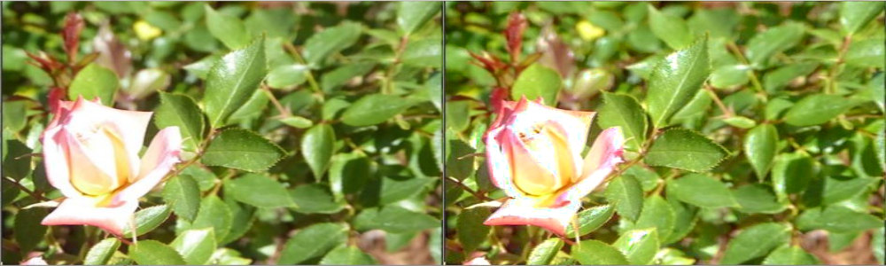
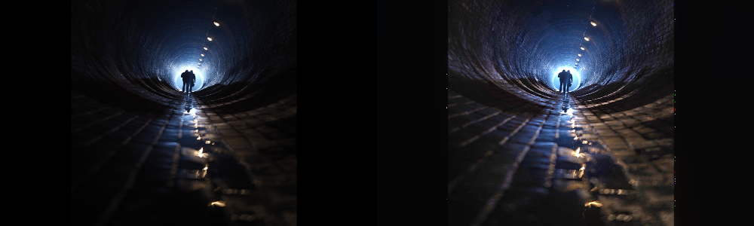
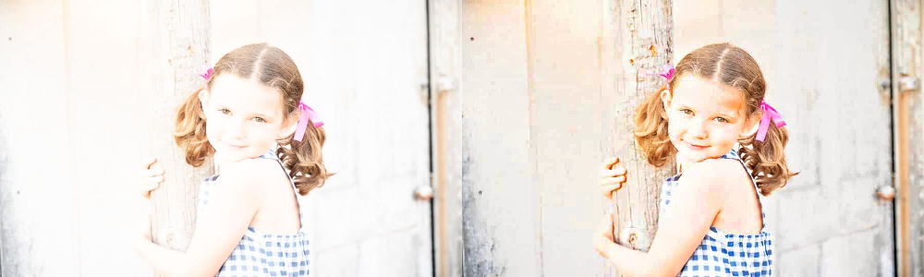
FEW RESULTS...
ORIGINAL
IMAGE
RESULTANT
IMAGE
ORIGINAL
IMAGE
RESULTANT
IMAGE

Slide 8
SOME EXPERIMENTS...
1) Changing various Hyperparameters
2) Contrast Enhancement using Histogram Equalization
3) Dim light Video Conversion

Slide 9
1) Changing various Hyper parameters
We tried changing various hyper parameters like:
1) Gamma (Intensity Coefficient)
2) Lambda (Smoothness Coefficient)
3) Exposure
4) Contrast
5) Saturation

Slide 10
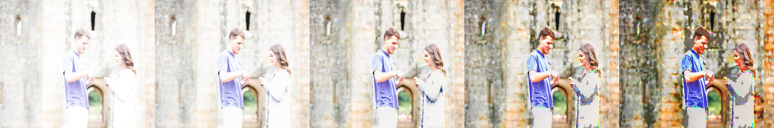

gamma
Original Image
Gamma Value
0.2
Gamma Value
0.4
Gamma Value
0.6
Gamma Value
0.8

Slide 11
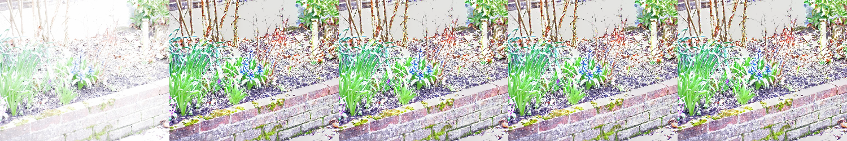

Lambda
Original Image
Lambda Value
0.01
Lambda Value
0.1
Lambda Value
0.45
Lambda Value
0.8

Slide 12
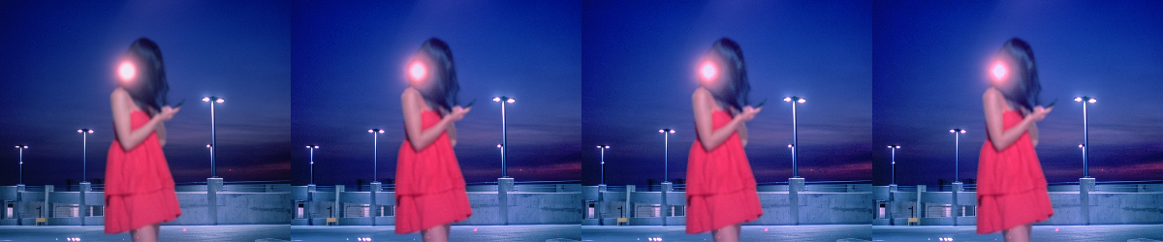
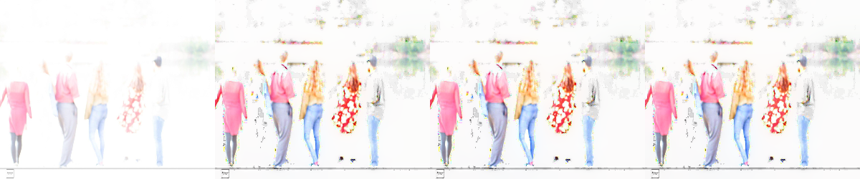
exposure
Original Image
Exposure Value
0
Exposure Value
0.5
Exposure Value
1

Slide 13
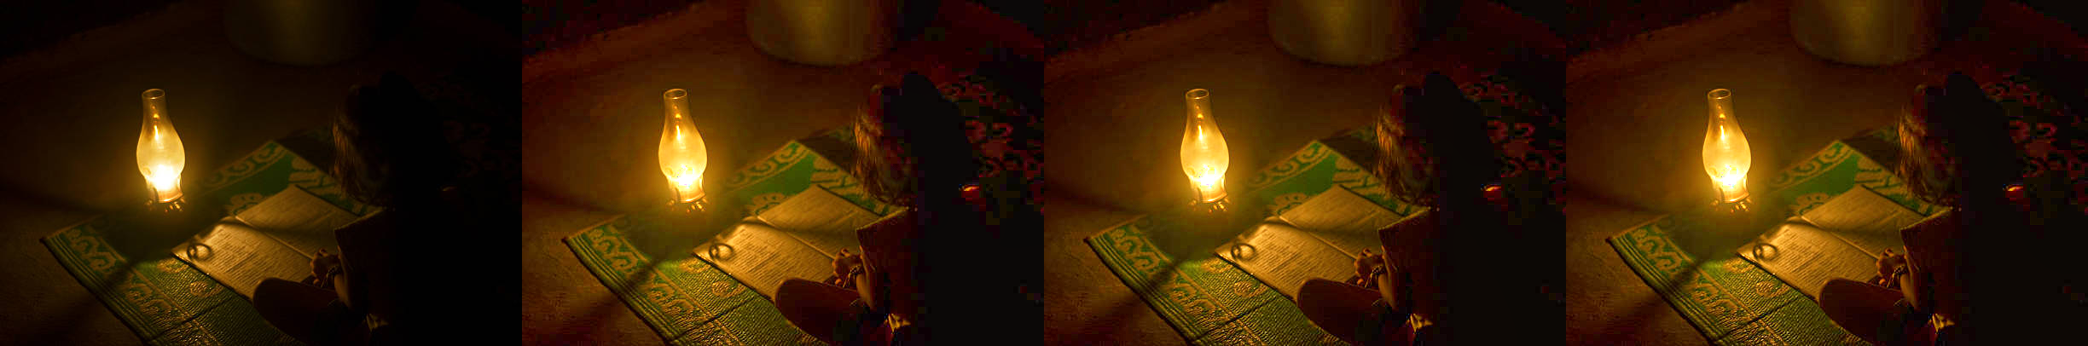

contrast
Original Image
Contrast Value
0
Contrast Value
0.5
Contrast Value
1

Slide 14
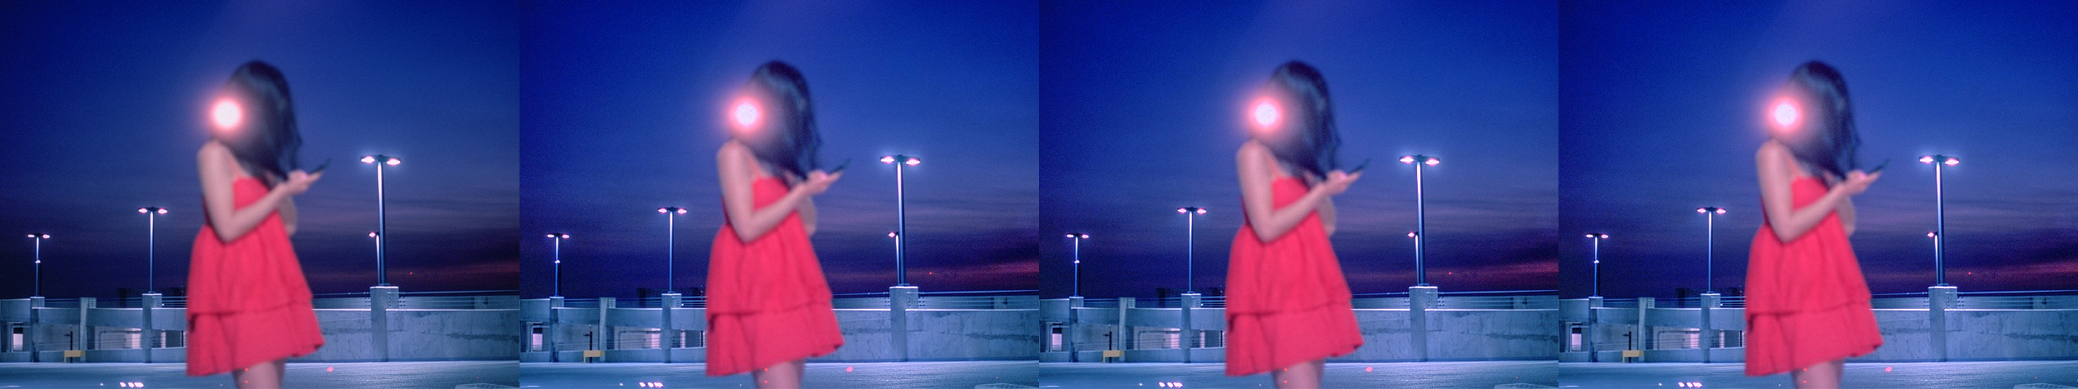

Saturation
Original Image
Saturation Value
0
Contrast Value
0.5
Contrast Value
1

Slide 15
2) CONTRAST ENHANCEMENT

Slide 16


Contrast enhancement using histogram Equalization
Increase the global contrast of images
Useful in images with backgrounds and foregrounds that are both bright or both dark
Sometimes produces unrealistic effects
ORIGINAL IMAGE
ENHANCED IMAGE

Slide 17
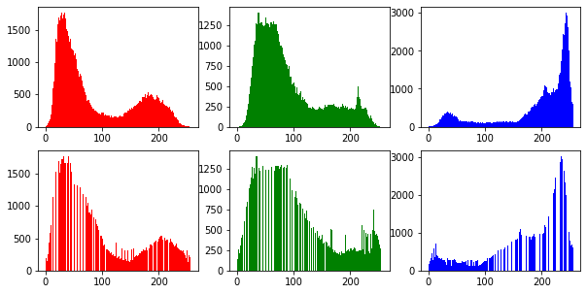
Visualization of Heq in each channel
Original
Image
Enhanced
Image

Slide 18
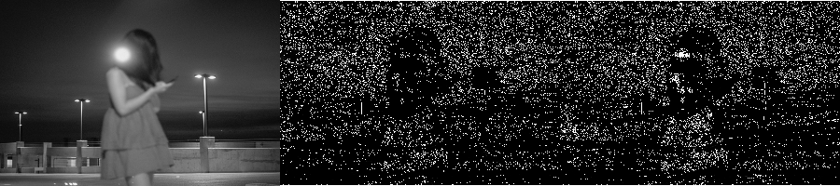
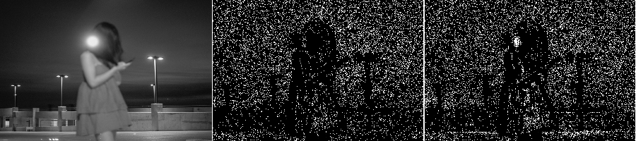
Effects of heq on smoothness weights (w)
Original weights
Enhanced weights
Along
X-axis
Along
Y-axis

Slide 19
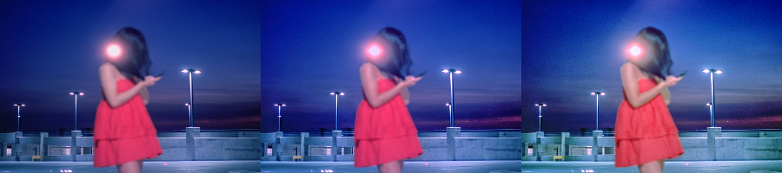
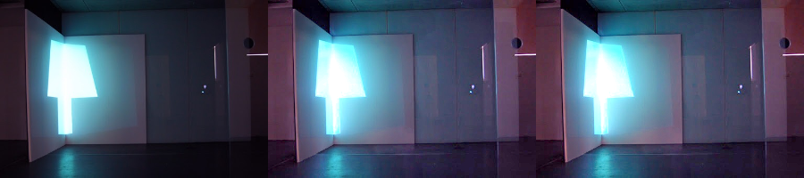
Using enhanced image during fusion phase (underexposed)
Using enhanced image in fusion
Original Image
Using original image

Slide 20
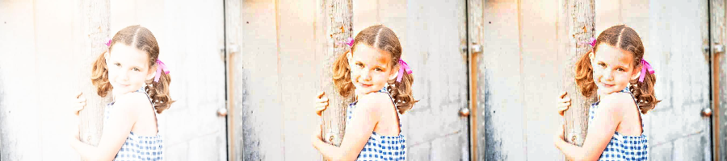
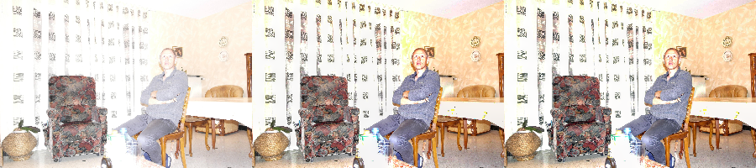
Using enhanced image during fusion phase (overexposed)
Original Image
Using original image
Using enhanced
image in fusion

Slide 21
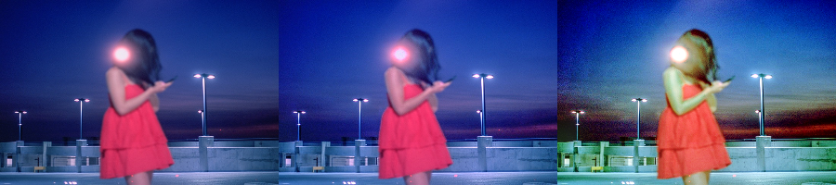
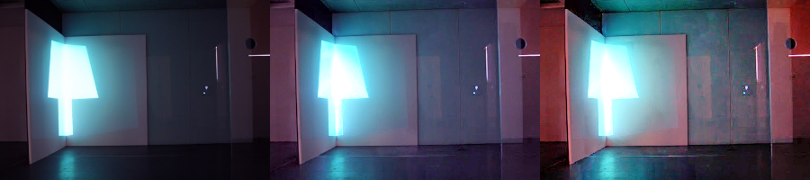
Using enhanced image during dual illumination phase (underexposed)
Original Image
Using original image
Using Enhanced Image in Dual Illumination Phase

Slide 22

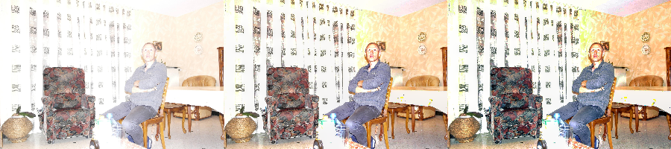
Using enhanced image during dual illumination phase (underexposed)
Using original image in dual illumination phase
Using Enhanced Image in Dual Illumination Phase
Original Image

Slide 23
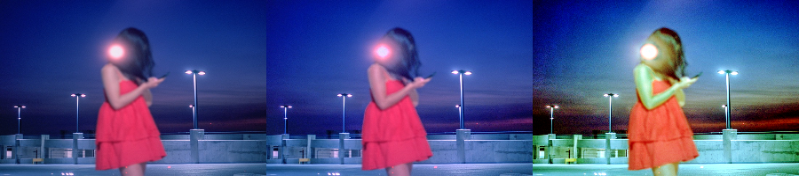
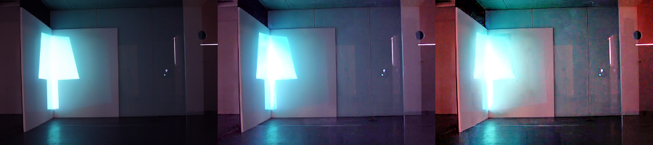
Using enhanced image during both phases (underexposed)
Using Enhanced Image in both phases
Original Image
Using original image

Slide 24
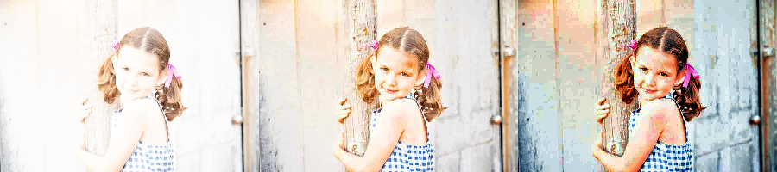
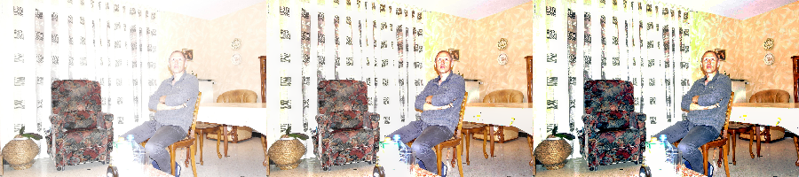
Using enhanced image during both phases (overexposed)
Original Image
Using original image
Using Enhanced Image in both phases

Slide 25
3) Dim-light Video Conversion
DEMO

Slide 26
THANK YOU

